Slide 1
CCABM: a uniquely CAPABLE and well-validated activity-based model

Slide 2
Agenda
Background
Software platform & model user interface
Advantages of CCABM
Conceptual framework
Technical strengths
User experience

Slide 3
background
CCABM: Fully disaggregate Activity-Based Model (ABM)
Evolved from advanced trip-based and hybrid models
Calibrated and validated for multiple regions
AMBAG (Monterey Bay, CA)
Oahu, HI
Peoria, IL
CCABM components feature in several hybrid models
Las Vegas, NV and Reno, NV

Slide 4

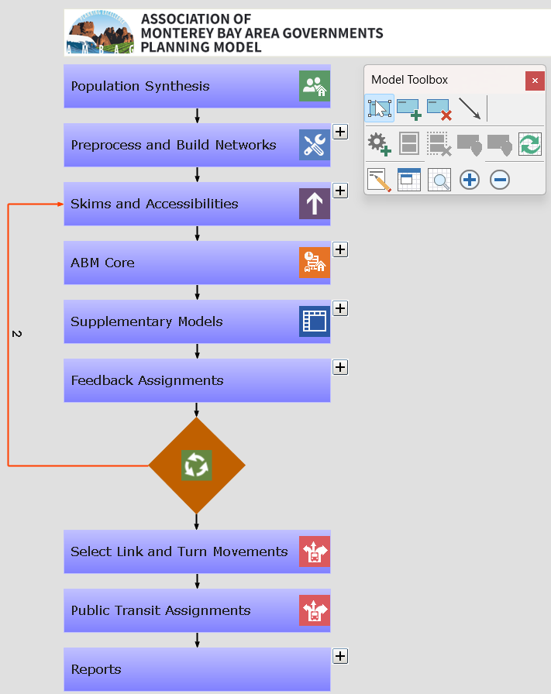
Software platform & model user interface
CCABM: Caliper’s Activity-Based Model (ABM)
Feature-rich, customizable, practical
Graphical user interface
Review inputs, run and manage scenarios
Built using TransCAD
TransCAD architecture tailored for disaggregate models
Consistent, efficient data formats in one platform
Database engine tags/joins disparate datasets as needed
Does not use large, duplicative intermediate files
Used by two-thirds of US MPOs
Native GIS & fast Logit engine
Unparalleled fast network algorithms
Lowest run times and memory requirements

Slide 5
Advantages of ccabm
Better-validated than other US ABMs
Runs on standard, affordable hardware with minimal memory overhead
Realistic policy sensitivity
(e.g.) Sensitive to remote/hybrid work schedules by industry
(e.g.) Within-household vehicle use interactions
Open-source model scripts on the TransCAD platform
May be customized/modified
Easily estimated from local datasets to ground realities
Best user interface for ABMs
Manage scenarios rapidly via mouse clicks
Edit all model parameters, specs in one place
Post-process/visualize complex outputs with built-in TransCAD tools
Customize intuitive dashboards and reports
Multiple successful deployments for other MPOs
Sample AMBAG Running Times
ABM Calculations
30 Minutes/Iteration
All Calculations
45 Minutes/Iteration
Full Model
< 4 hours for 5 loops

Slide 6
Conceptual framework
Generate Synthetic
Households, Persons
Compute Skims, Accessibilities
Feedback
Run ABM for Residents
Collate Demand: Residents, Visitors, Trucks, …
Write Reports & Summaries
No
Run Traffic Assignments
Converged?
Run Transit Assignments
Yes

Slide 7
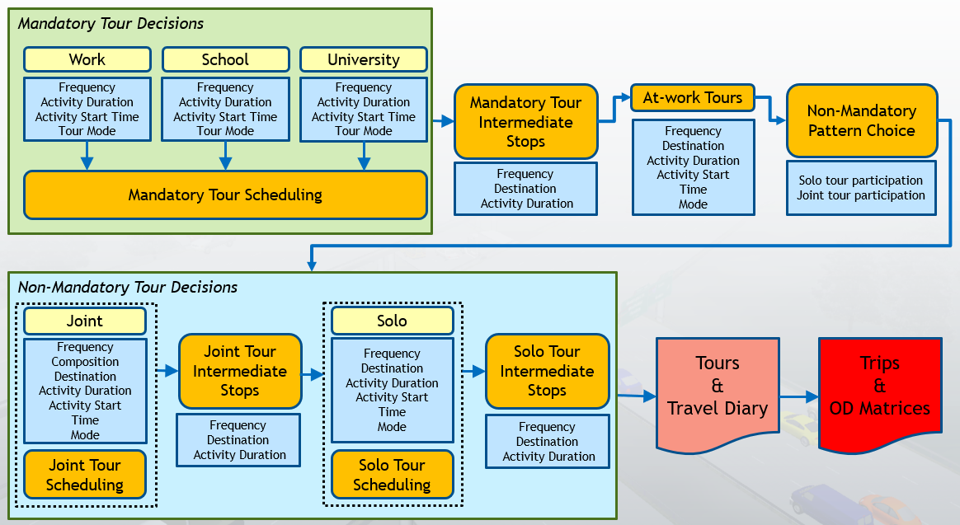
Conceptual framework
ABM components: detailed overview

Slide 8
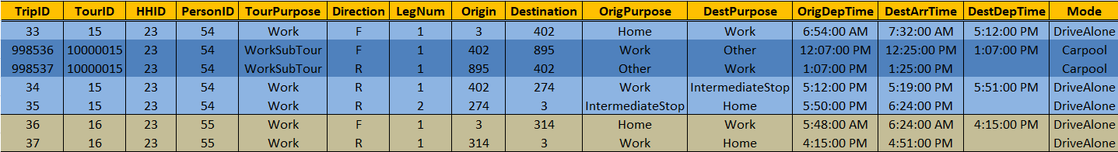
SAMPLE outputs
Detailed, consistent decisions by individuals & households
First example household:
Person 1: Home > Work > Stop > Home with an at-work tour
Person 2: Home > Work > Home

Slide 9
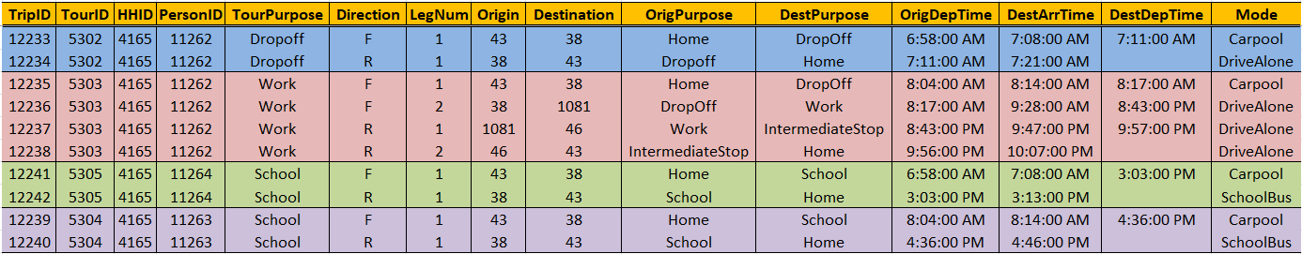
Sample outputs
Detailed, consistent decisions by individuals & households
Second example household:
Person 1: Home > School Drop-off > Home
Person 2: Home > School Drop-off > Work > Stop > Home
Person 3: Home > School > Home (returns by school bus)
Person 4: Home > School > Home (returns by school bus)

Slide 10
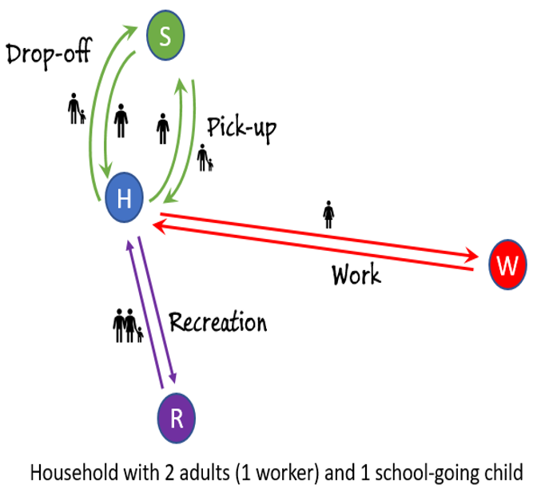
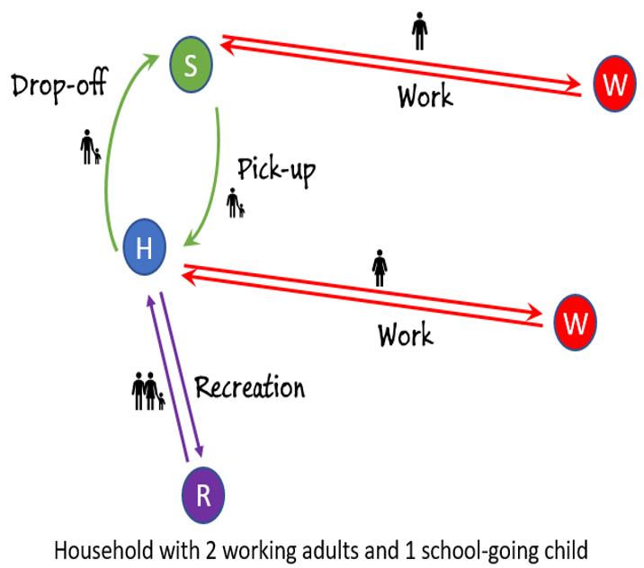
Technical strengths
Specifications and parameters are estimated, not asserted
Highly efficient population synthesizer
Matches both household & person distributions
State-of-the-art nested location models
Pioneered by Caliper, greatly improves fit
Auto ownership model
Detailed household interactions
School pick-up/drop-off, vehicle allocation
Built-in time/schedule manager
Customized model calibration menu

Slide 11
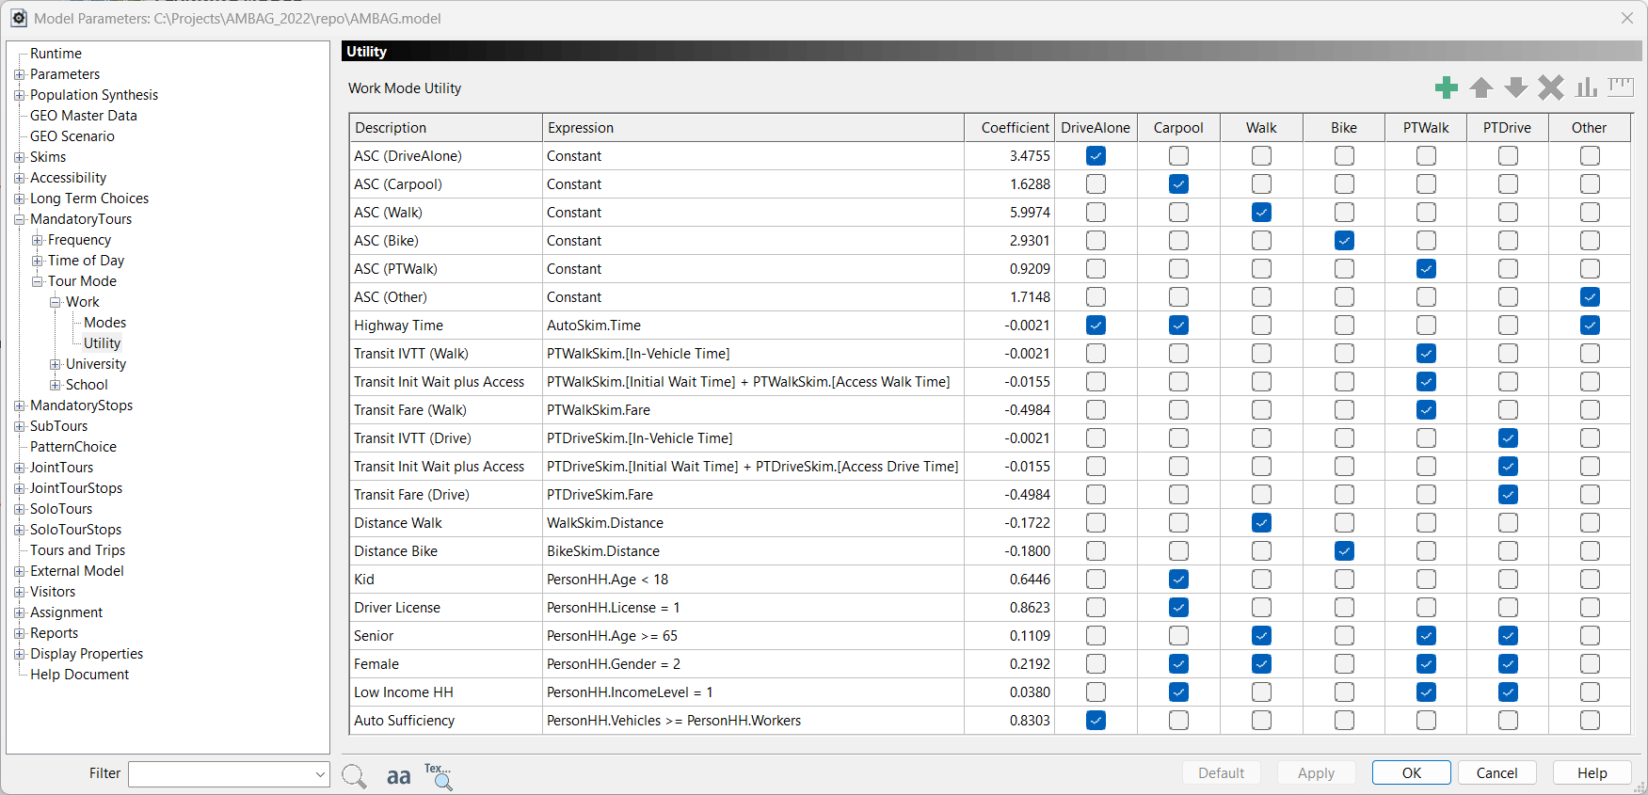
User experience
TransCAD user interface is easy to learn and use
Flowchart and parameter views offer transparent, one-stop model parameter management
Quickly review any model step
Create/edit coefficients

Slide 12
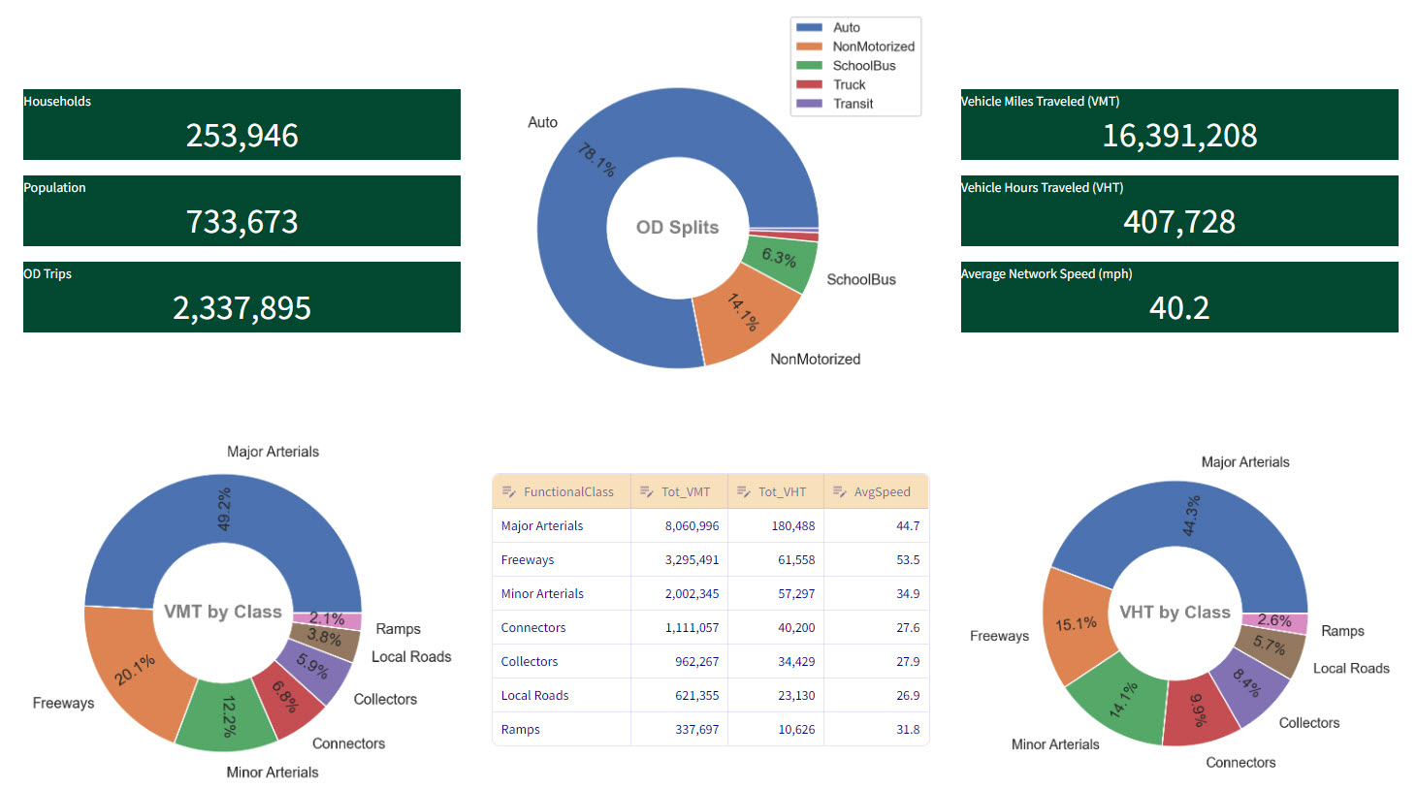
User experience: Summary Dashboard

Slide 13
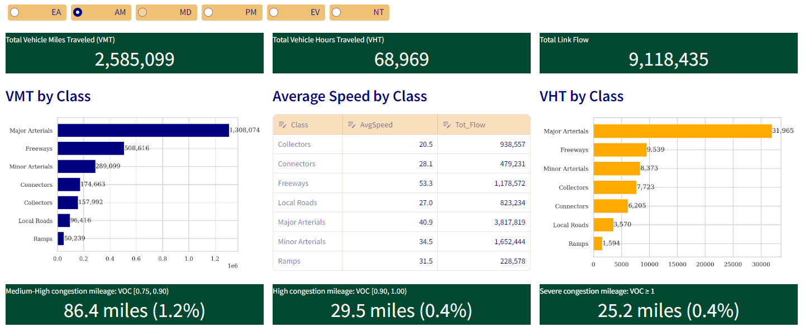
User experience: assignment Dashboard

Slide 14
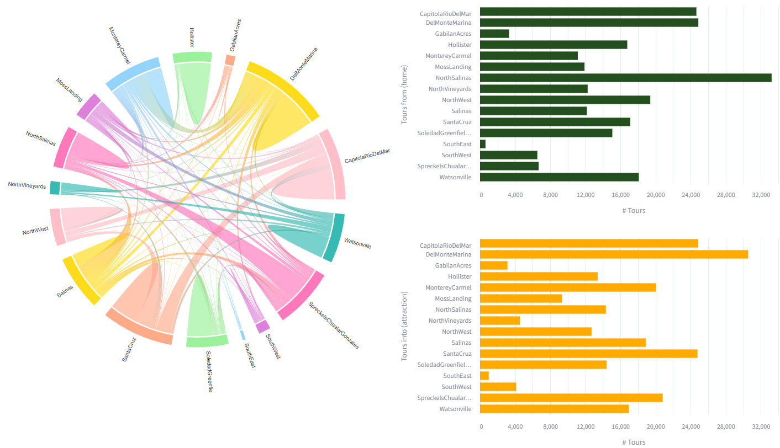
User experience: cluster flows Dashboard

Slide 15
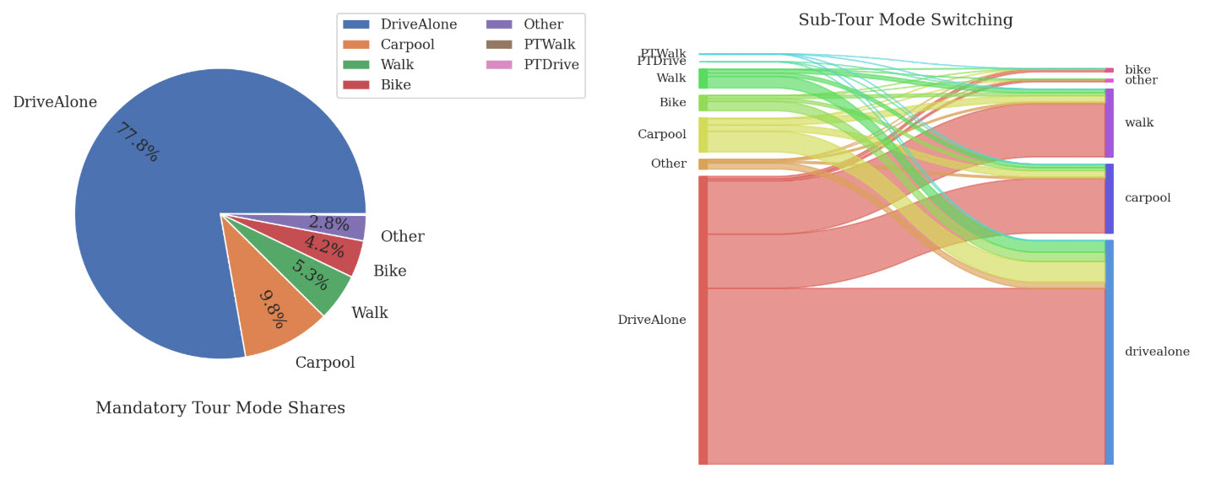
User experience: mode summary Dashboard

Slide 16
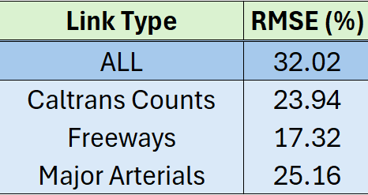
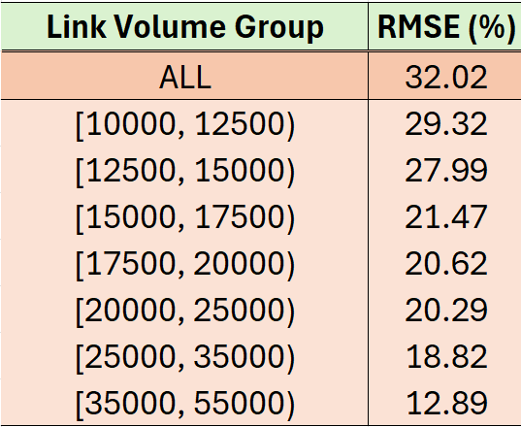
Model calibration
Comparison to traffic counts
Achieves accuracies consistent with simpler, trip-based/hybrid models
Simultaneously delivers enhanced policy sensitivity with disaggregate modeling and outputs
VMT compares favorably with well-validated current hybrid model
Values are within ~5%

Slide 17
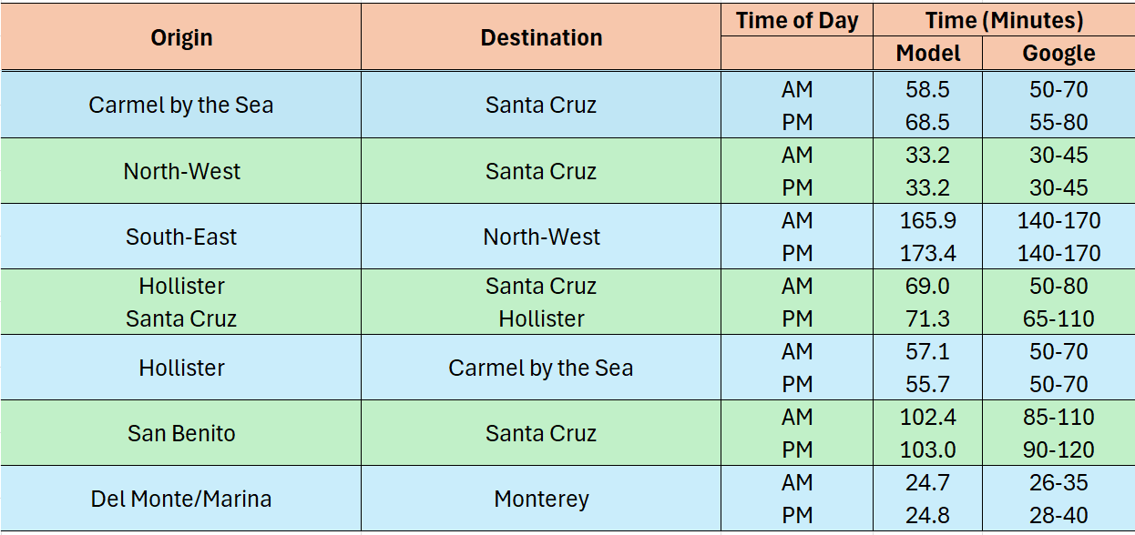
Model validation
Validation to Google origin-destination (OD) travel times

Slide 18
Rama Balakrishna, PhD | Principal Transportation Scientist
rama@caliper.com
Srinivasan Sundaram | Principal Transportation Engineer
srini@caliper.com
Kyle Ward | Senior Data Scientist
kyle@caliper.com

